Slide 1
Texas A&M San Antonio Area
Regional Center
Virtual Planning Team Meeting: Draft Mobility Recommendations
Thursday, October 1, 2020
10:00 AM

Slide 2
Meeting Objectives
Welcome & Introductions
Project schedule
Housing and Economic Development Q&A
Consider.It platform walk through
Mobility Recommendations Discussion
Walk-through of website
Questions?

Slide 3
Introductions

Slide 4
Project and Process Schedule

Slide 5
Overall of Planning Team Meetings
Meeting #1: Kick-Off and Orientation; Sub-Area Plan Overview
Meeting #2: Preliminary Identification of Opportunities of Challenges; Preliminary Visioning
Meeting #3: Confirm Vision and Goals; Focus Areas and Corridors
Meeting #4: Housing and Job Projections; Land Use (1 of 2)
Meeting #5: Land Use (2 of 2)
Meeting #6: Housing and Economic Development Strategies (1 of 2)
Meeting #7: Housing and Economic Development Strategies (2 of 2)
Meeting #8: Mobility
Meeting #9: Infrastructure and Amenities
Meeting #10: Mobility (2 of 2)
Meeting #11: Review Digital Design Charrette; Focus Areas; Neighborhood Profiles & Priorities
Virtual “Check-in” Meeting : Update, revised project schedule, walk-through of website content
Extra Meeting: Mobility
Extra Meeting: Amenities and Public Spaces, Focus Areas and Transformative Projects
Meeting #12: Plan Framework Map & Recommendations; Implementation Prioritization and Phasing
Meeting #13: Public Draft Review & final revisions, process feedback
Notes:
We are wrapping up the future land use mapping, although this map will truly not be finalized until it has been through public comment and City Council adoption with the Regional Center Plan.

Slide 6
Housing & Economic Development

Slide 7
Consider.It
https://texasam.consider.it/
https://texasam.sacompplan.com/

Slide 8
Mobility

Slide 9
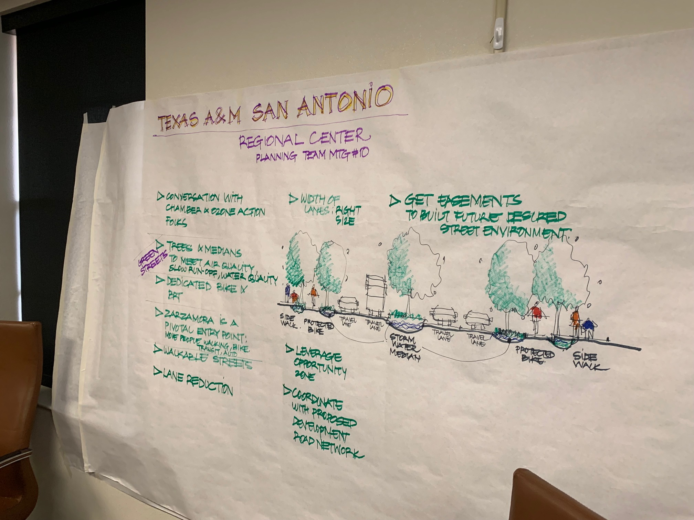
How did we get here?
Notes:
We are wrapping up the future land use mapping, although this map will truly not be finalized until it has been through public comment and City Council adoption with the Regional Center Plan.

Slide 10
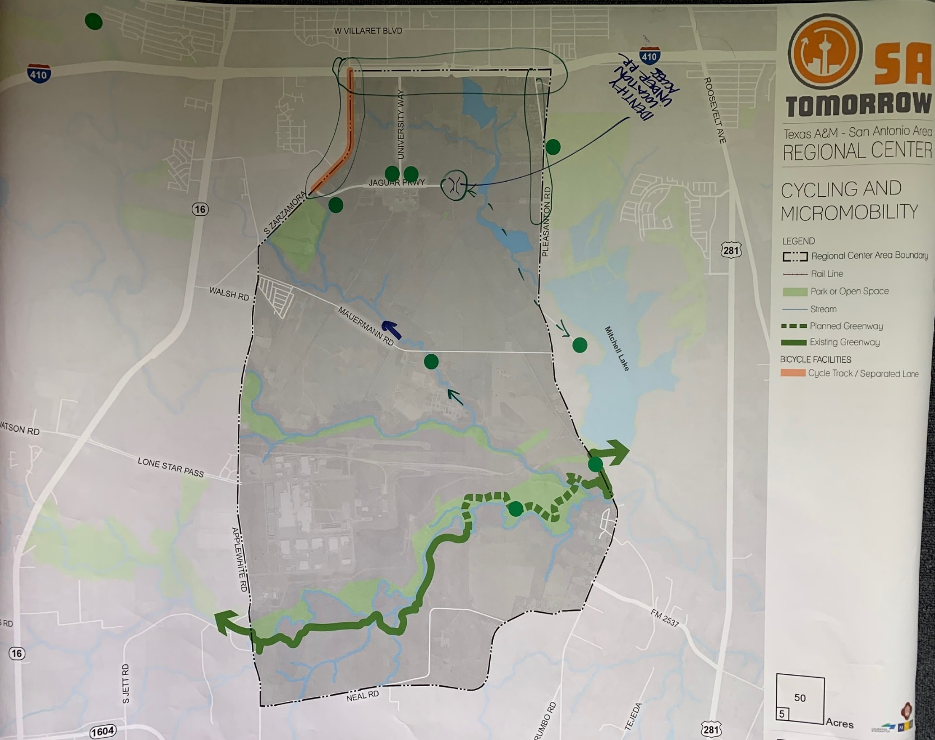
Planning Team Meeting #8: October 8, 2019
Cycling and Micromobility
The team identified both sides of Jaguar Parkway, Mauermann Road and Leon Creek, the Medina River Trailhead and the Mitchell Lake Audubon Center as supporting a destination or origin for cyclists.
Notes:
We are wrapping up the future land use mapping, although this map will truly not be finalized until it has been through public comment and City Council adoption with the Regional Center Plan.

Slide 11
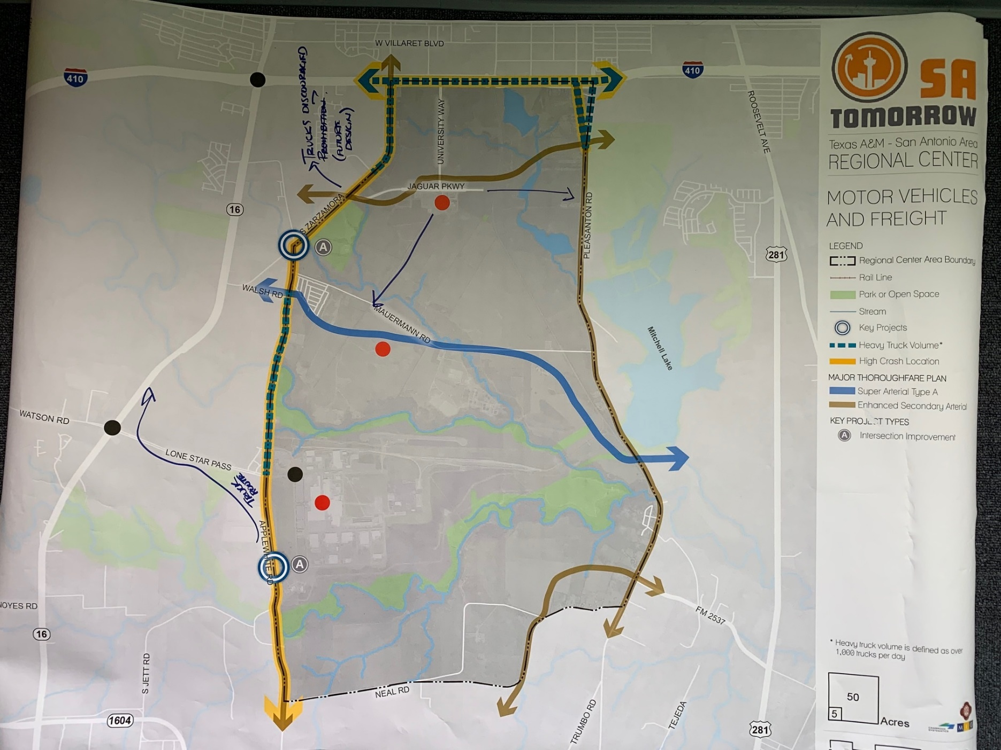
Planning Team Meeting #8: October 8, 2019
Motor Vehicles and Freight
Participants identified the industrial uses directly south of Mauermann, the Toyota Motor Manufacturing Plant, and the A&M-SA campus as supporting freight origins and destinations. Notes were made to identify SH 16 as an alternate route for freight to avoid traffic on Zarzamora and SH 16 has direct access to Loop 410. Also, it was noted that freight use may be discouraged on University Way, with the exception of campus deliveries
Notes:
We are wrapping up the future land use mapping, although this map will truly not be finalized until it has been through public comment and City Council adoption with the Regional Center Plan.

Slide 12
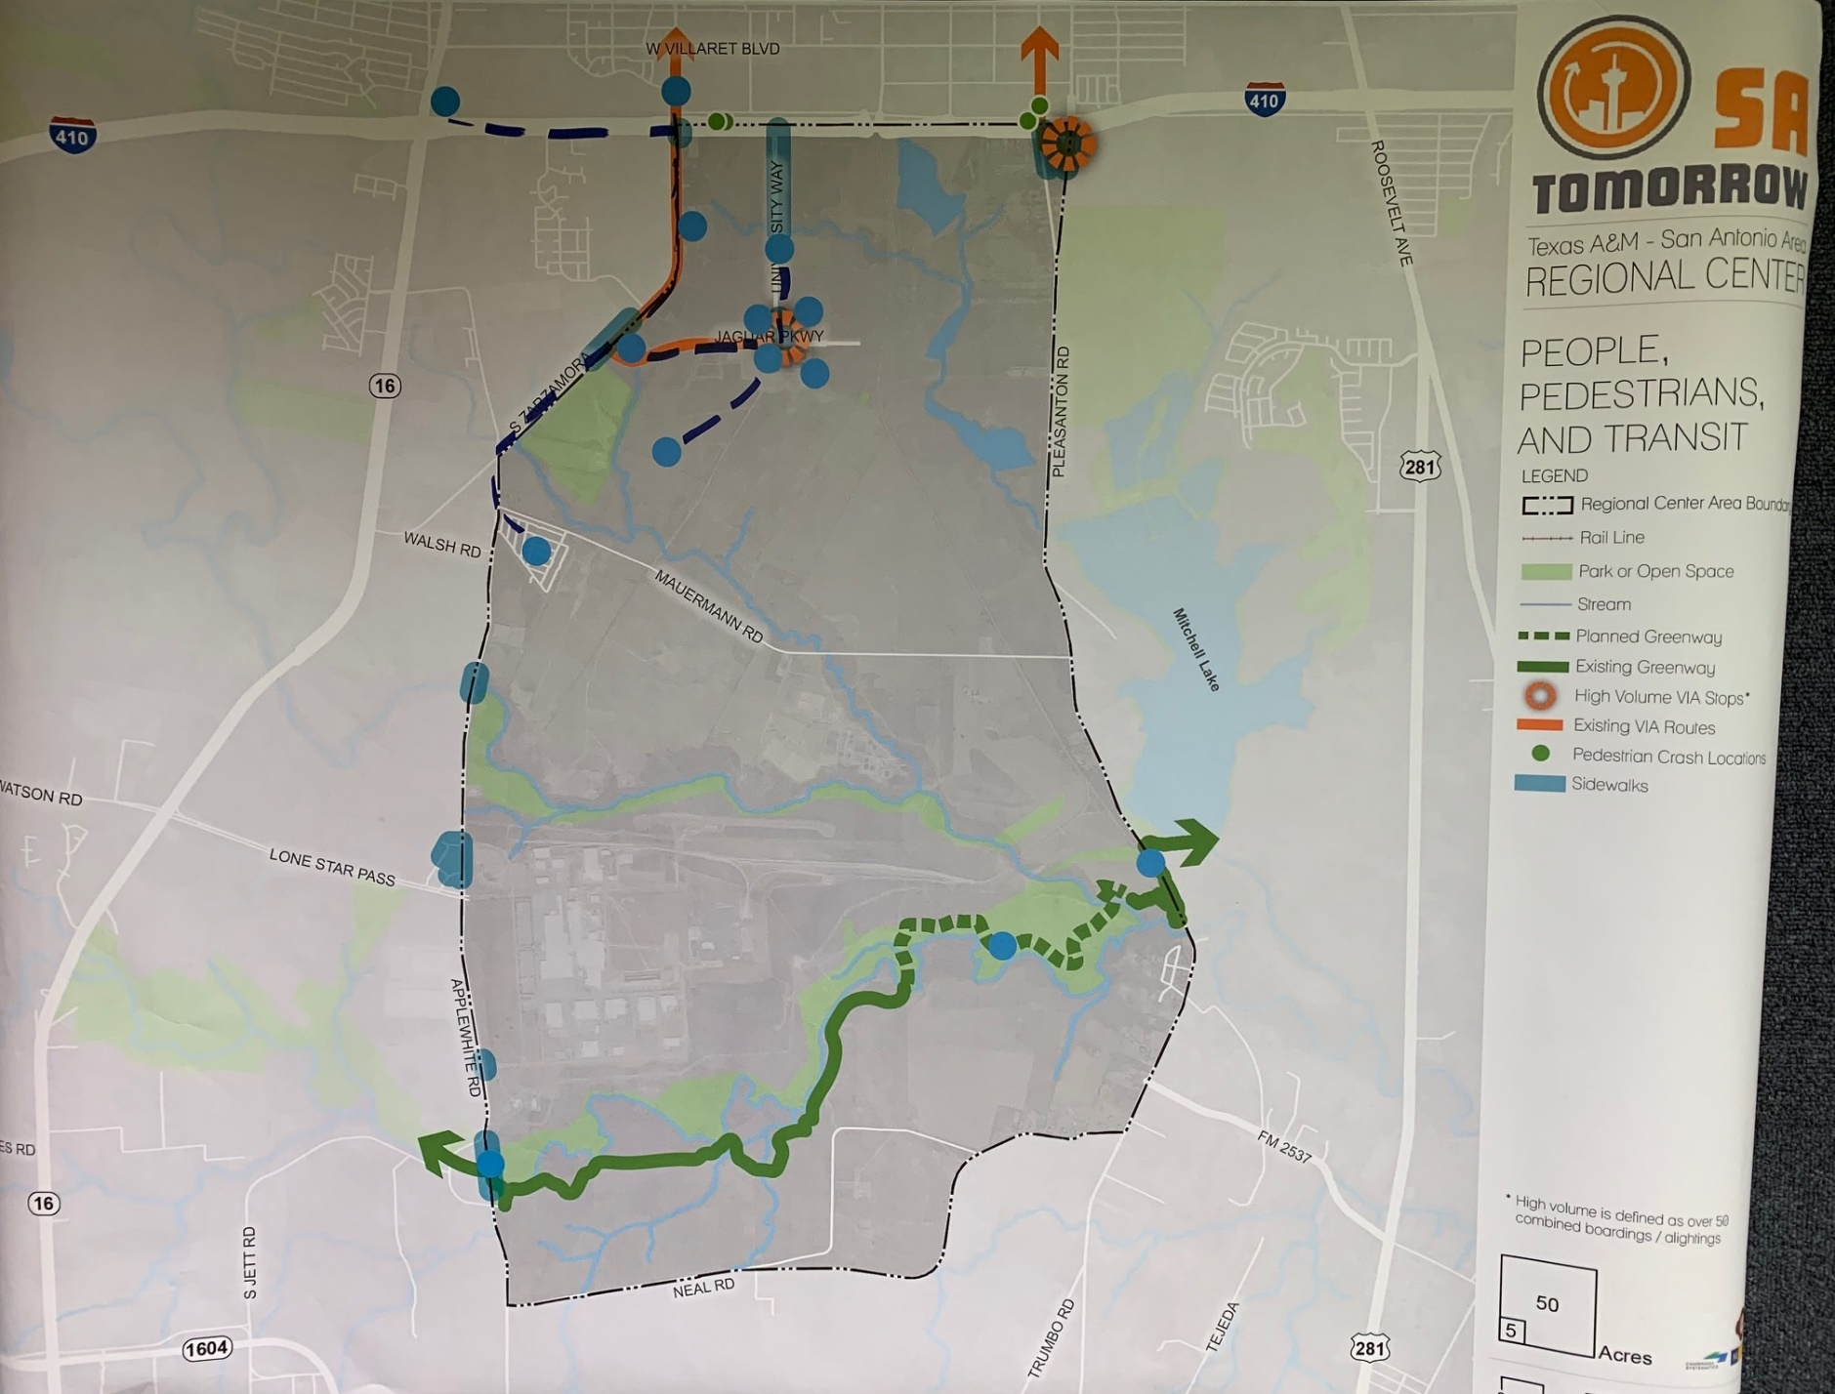
Planning Team Meeting #8: October 8, 2019
People, Pedestrians and Transit
Participants identified origins and destination in the area around Jaguar Parkway and University Way, Zarzamora Road, the Medina River Trail, and the area north of 410-providing a pedestrian or transit connection to Palo Alto College
Notes:
We are wrapping up the future land use mapping, although this map will truly not be finalized until it has been through public comment and City Council adoption with the Regional Center Plan.

Slide 13
Planning Team Meeting #8: October 8, 2019
Key Takeaways:
Issues and Opportunities
The area is in transition with the growth of A&M-SA and the master planned Vida San Antonio development. There are fundamentally different needs, given the areas current condition.
West to East connections are vital. Mauermann Road is the only West to East Connection.
The team noted that there are opportunities for a more extensive trail network, and that complete green streets should be emphasized.
Notes:
We are wrapping up the future land use mapping, although this map will truly not be finalized until it has been through public comment and City Council adoption with the Regional Center Plan.

Slide 14
Planning Team Meeting #10: December 10, 2019
Mapping Exercise pt. 2
The team was asked to identify any missed linkages. The team identified University way and 410 through Chavaneaux Road that could be linked to Palo Alto College. Bike Infrastructure was also discussed, considering the proposed grid network for the Vida Community.
A major advantage is the fact that much of the right of ways are undeveloped and provide opportunity for sound development.
The team also identified freight opportunity along Palo Alto Rd into the Toyota Motor Manufacturing Plant on Lone Star Pass.
Notes:
We are wrapping up the future land use mapping, although this map will truly not be finalized until it has been through public comment and City Council adoption with the Regional Center Plan.

Slide 15
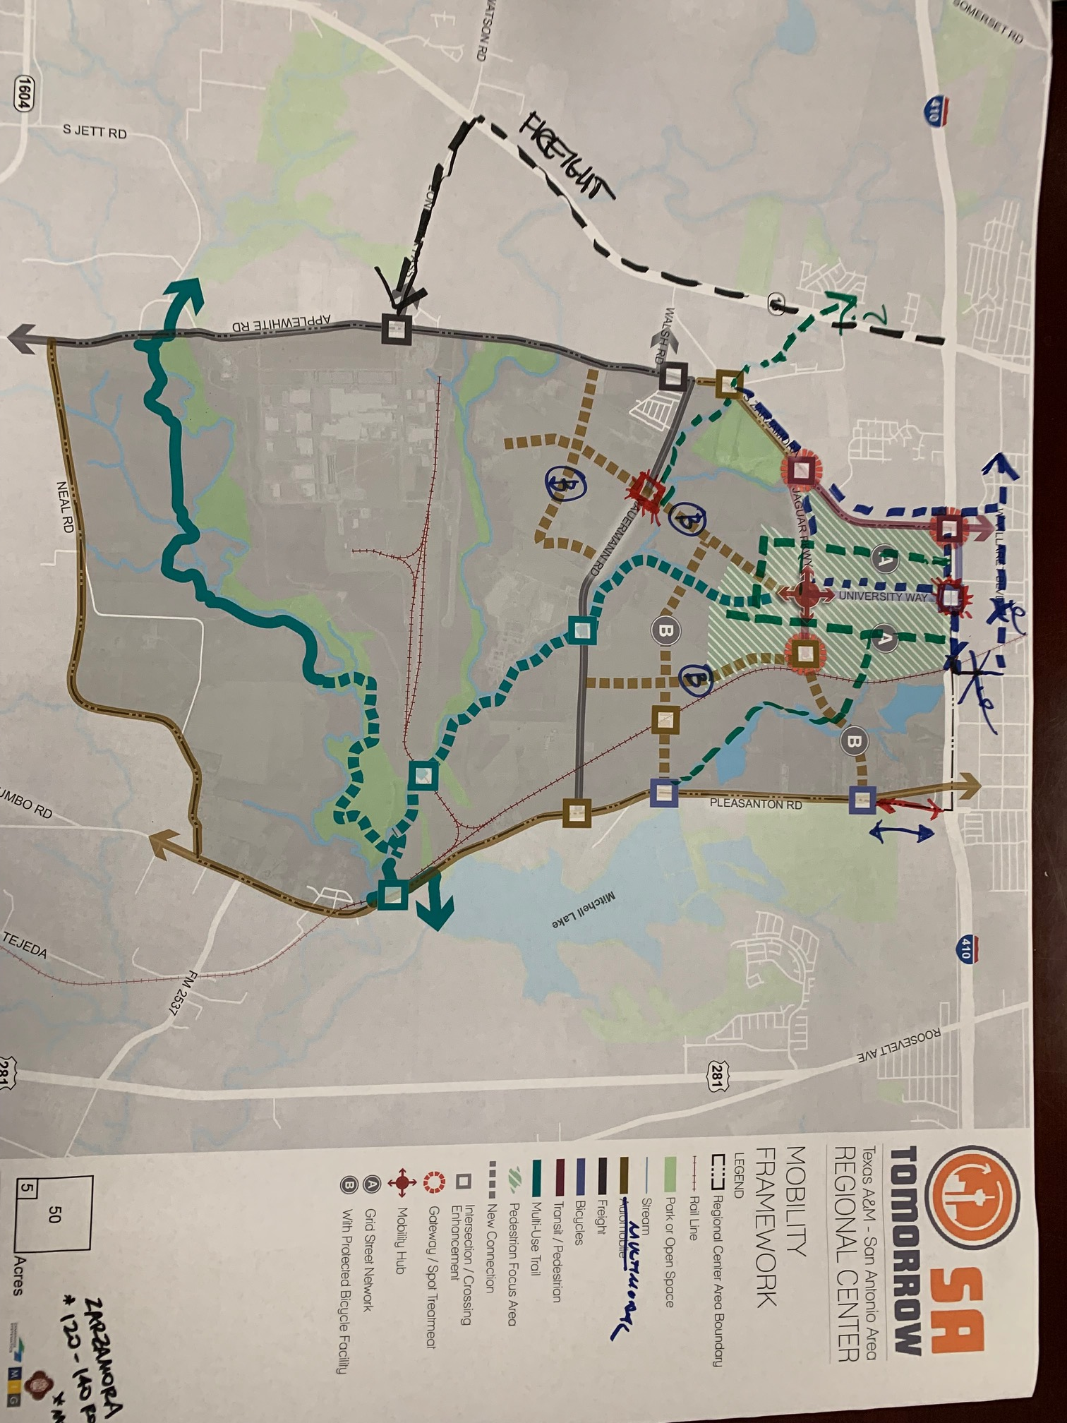
Planning Team Meeting #10
Notes:
We are wrapping up the future land use mapping, although this map will truly not be finalized until it has been through public comment and City Council adoption with the Regional Center Plan.

Slide 16
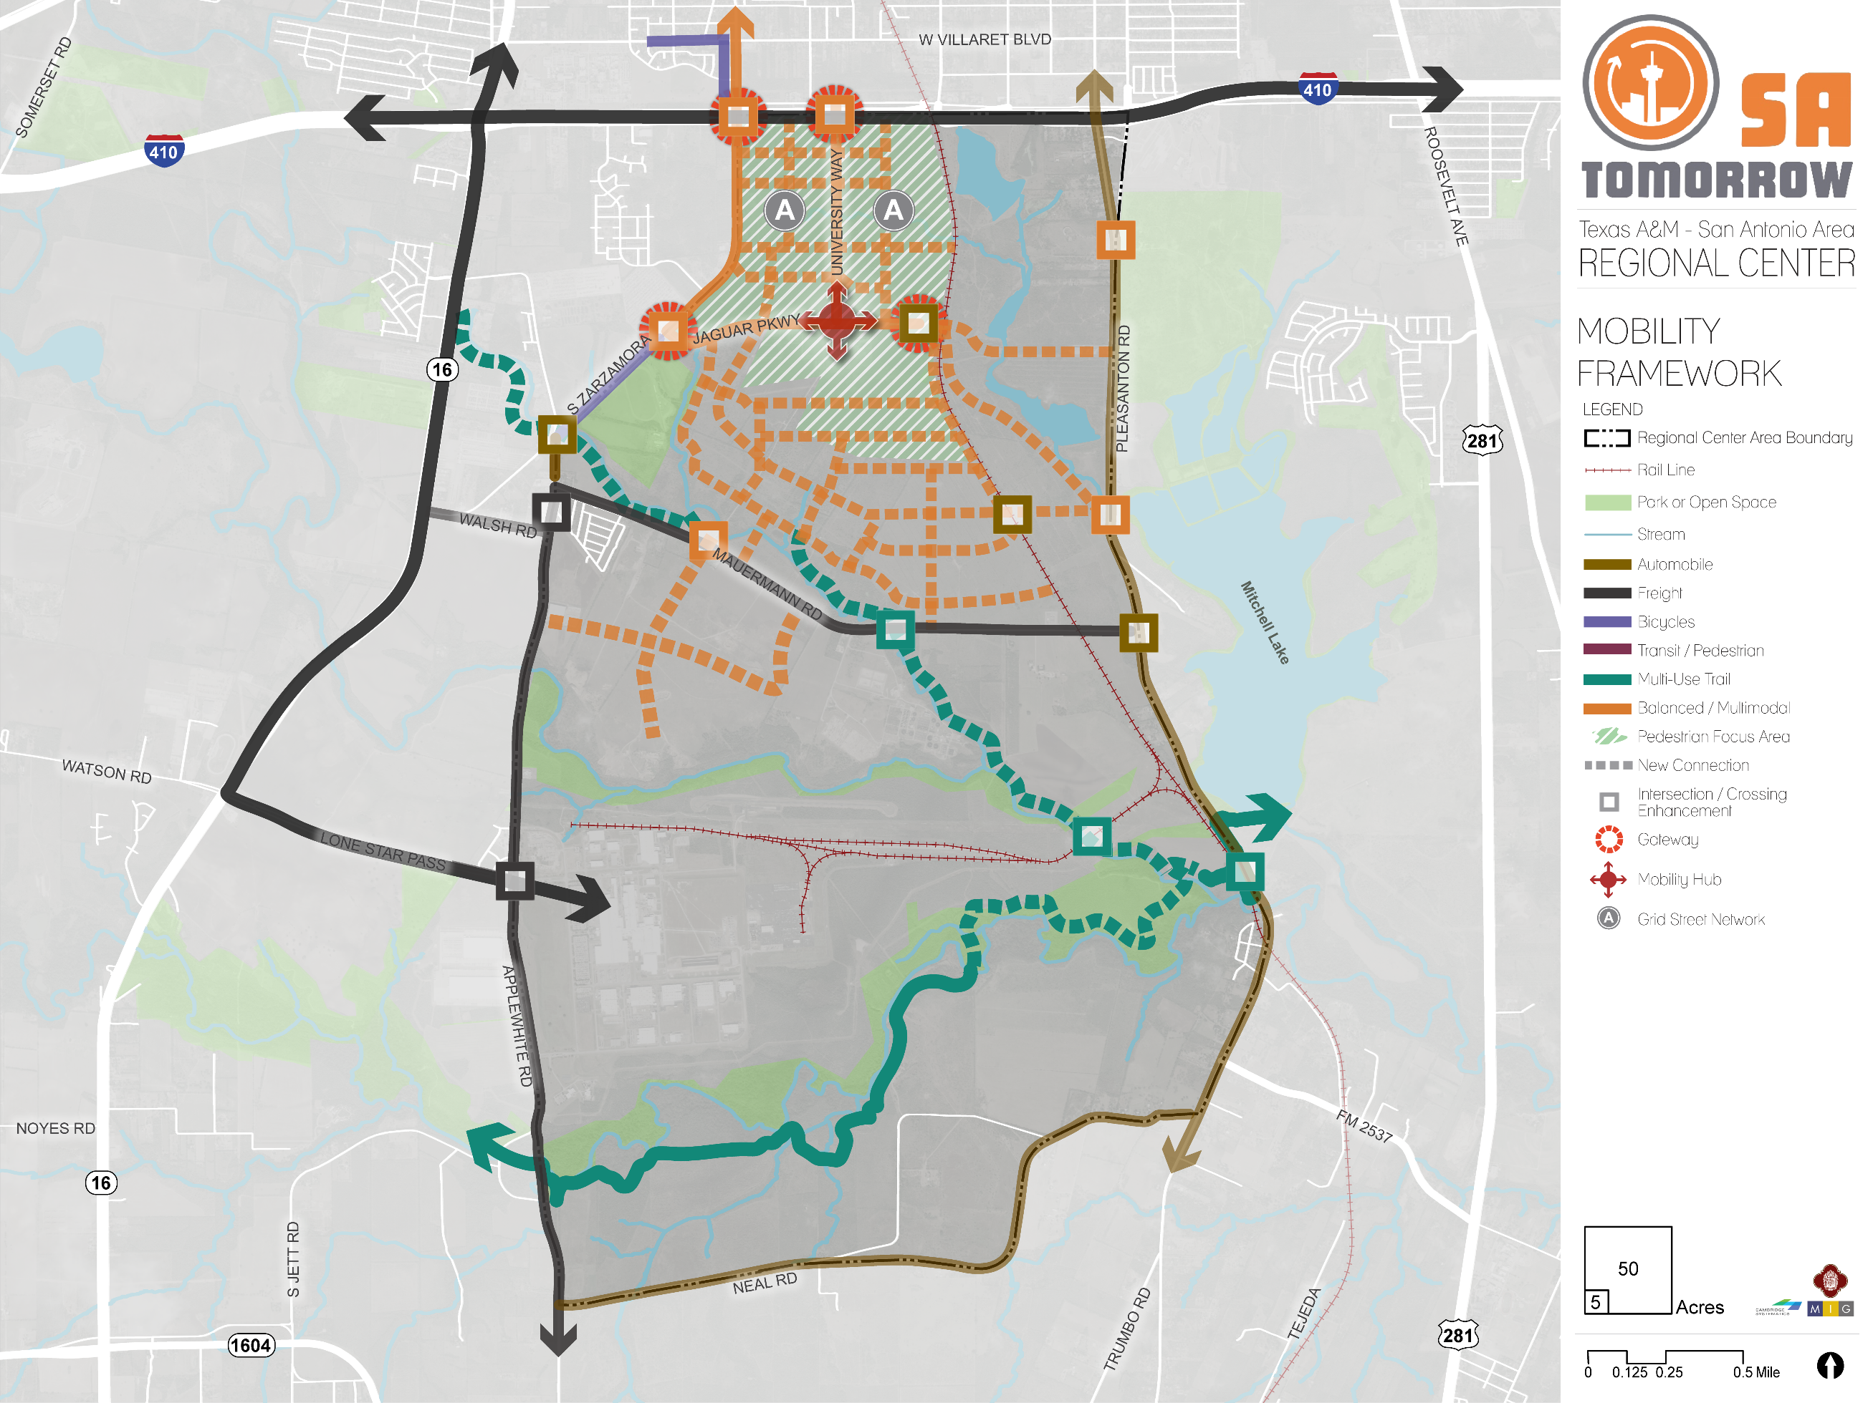

Slide 17
Website Walk-Through

Slide 18
Website Walk-Through
https://texasam.sacompplan.com/
https://texasam.sacompplan.com/plan-framework/mobility-framework/

Slide 19
Draft Mobility Recommendations
Continue implementing the San Antonio Vision Zero Action Plan
Create a grid network of multimodal and low impact streets
Manage future transportation demand through deliberate parking management strategies and traffic management plans that prioritize pedestrian, bicycle and transit options during special events.
Consider freight movements and needs in land use transportation planning activities.
Support VIA Metropolitan Transit service by prioritizing transit supportive policies and infrastructure near transit stations.

Slide 20
Next Steps
Planning Team Meeting (Amenities and Public Spaces) Week of October 28th.
Virtual Platforms and Virtual Office Hours
Questions?
Carlos Guerra II
Project Manager
carlos.guerra2@sanantonio.gov

Slide 21
Texas A&M San Antonio Area
Regional Center
Virtual Planning Team Meeting: Draft Mobility Recommendations
Thursday, October 1, 2020
10:00 AM

